Slide 1
Report writing: structures, conventions, and processes for engineering
By Pam Mort & Dr Alexander Von Brasch et al.
Prepared by Pam Mort, The Learning Centre ©UNSW 2010 -2018
COPYRIGHT CONDITIONS
This is a publicly available resource for staff and students at UNSW. UNSW students may download a single copy for individual study purposes. UNSW staff may also use the resource for teaching purposes. No parts of this resource may be reproduced without permission from the author. If educators or institutions not part of UNSW would like to use the resource in their own courses, written permission is required.
Please contact Pam Mort (p.mort@unsw.edu.au ) for permission and feedback

Slide 2



Why Write?
A professional’s opinion, advice, conclusion is needed and valued.
Writing
Is part of professional practice
Improves the writer’s clarity of thought
Improves your learning & understanding
Provides an opportunity for feedback on your ideas & knowledge
Use your time at University to hone your written communication skills!

Slide 3

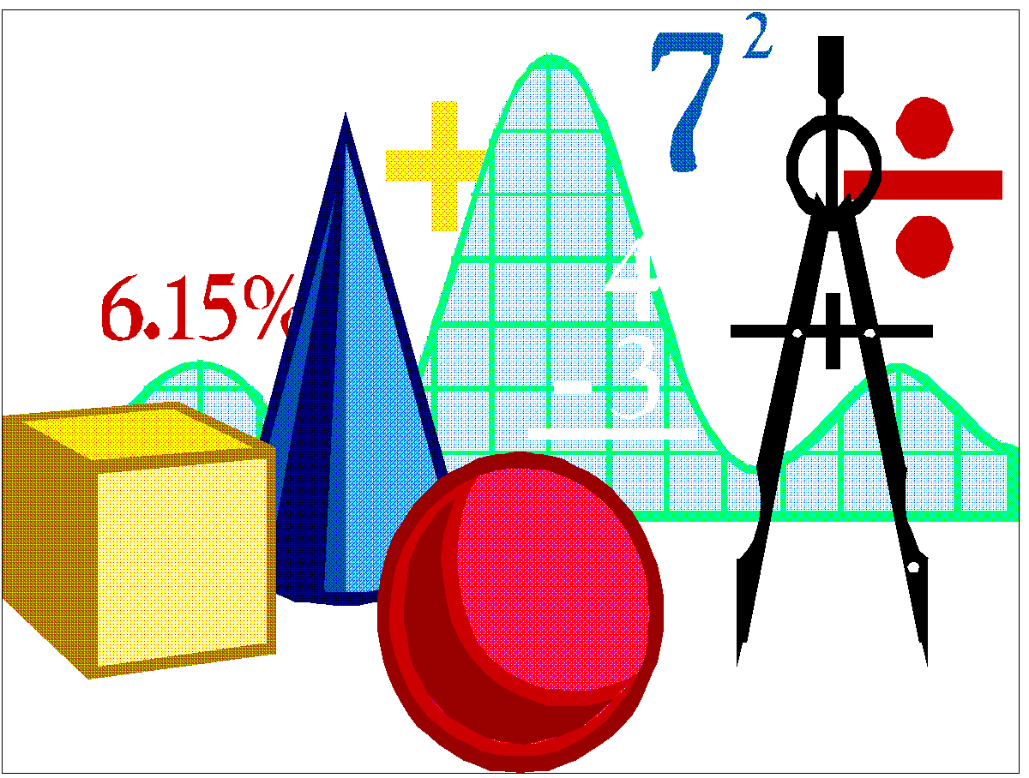

Why engineers think writing is important
Writing:
Is a major form of communication in the workplace
Provides a record of decisions and recommendations.
Provides information on design, processes, specifications and instructions.
Can be referred to in legal situations.[Hotel New World]

Slide 4
A few words about collaborative writing
Work method.
Establish and enforce a good plan or schedule
have good version control
agree on appropriate tools
create and use drafts
agree on text modifications
have several revisions
Group issues.
have good communication
have weekly face to-face meetings
Project management issues.
have someone in charge (the project, the document, the final editing, the schedule, the style)
assign and clarify each person’s responsibilities

Slide 5
Writing is a process?
Clarifying
the task
Gathering
information
Taking notes
Comparing &
evaluating
information
Forming
a thesis
Organizing
ideas
Writing drafts
Considering
the audience
Editing
often

Slide 6
A confusing paragraph
The car got a slow start but ended up flying down the track, achieving a third place time of 8.47 seconds. With the gears separating halfway down the track, this was an excellent feat. After making some changes, we did not preform as well as the first run (or as expected) in the second run, with the vehicle catching on the guide and spinning out to give us a 10.9 second average overall.

Slide 7
from the same report!!!!
Throughout the construction phase, the team needed to refocus on the marking criteria and design objectives as overall, this task was indeed about grades as well as speed.
Cost was minimised by using simple materials throughout the construction to ensure the project remained under budget. In terms of simplicity, the construction design was reworked so that the fan housing and the chassis were separate components that could be easily transported and stored, and then locked together on race day. In terms of manufacturability, the team considered this to be a difficult concept as it seemed unrealistic that the models would be mass-produced. However use of simple materials and a minimum number of moving parts does enhance the overall manufacturability, as well as simplicity. The redesigned fan-box and in particular the space-frame chassis design should contribute well to the innovation marks.
Main point
Cost
Simplicity
Manufacturability
Innovation

Slide 8
At the very least…
Set up a master document – consistent format
Decide who/whom will write the first complete draft - Receive draft written contributions from team members?
Write a first draft
Allow time so all members can proofread
Have a meeting to decide what is
essential information( keep)
interesting information (may keep)
nice to know information (chuck)
Improvements/changes to the document
From notes at this meeting- revise
proofread again meet  note changes 

Slide 9
Reports - A general structure
What is the topic of the report?
What was the purpose, conclusions and outcomes of this report?
How is the report organised?
What is the problem, background and purpose of this report?
What did we find out and how do we know this?
What are the key findings and outcomes?
Whose work, information and images are referred to in the report?
Who helped us?
What extra information may be useful for the reader?
Title page
Abstract/summary
Table of contents
Introduction
Body (See assignment guides)
Conclusion & recommendations
References
Acknowledgements
Appendices

Slide 10

Design Proposal
Your aims are:
to show the need for a technical solution to a problem,
to describe and justify your chosen idea/solution,
and to generate an initial plan for completing the project.
The proposal answers why, what, how, who, where, when?
“ the ultimate purpose of a proposal in the professional world is to sell a design proposal to a prospective client” (Dominik et al. 2001 p.108)

Slide 11
Proposal structure*
What is the situation being investigated? What is the goal/aim or the project/activity?
Preliminary information
Title page
Summary
Introduction
Problem formulation
System Overview
System + Component Design
Project planning
Summary/conclusion
Acknowledgements
References
Appendices
What is the nature of the problem? What science, features, constraints, and components need to be considered?
What design concept/s is proposed?
How will the design/system work?
Body of
the
report
How will the project be completed? Who is responsible for roles and tasks?
What risks and contingencies have been considered?
Supplementary information
*Adapted from C. Reidsema’s notes for ENGG1000
Notes:
Briefly describe the system or situation you are investigating (the brief)
Give some brief background – who needs the solution? Where would this solution be applied?
State what your project/solution will achieve.
Briefly describe the system or situation you are investigating (the brief)
Give some brief background – who needs the solution? Where would this solution be applied?
State what your project/solution will achieve.

Slide 12
Final design report structure*
Title page
Summary
Table of contents
Introduction
Design /Implementation*
Results and analysis*
Conclusions and recommendations*
References
Acknowledgements
Appendices
What was the brief?
Describe the final design of your solution, components, constraints etc.. What was your strategy?
Use visuals
How did you build your solution?.
Did you have any problems when you built it and tested it that required you to modify the design?
How did your design solution perform? (& why)
What were the good and bad features of your design solution?
What was the achievement and outcome of your design solution?
What did you learn about working in a team and the design process?
What improvements would you recommend for your design solution?
*Check individual report instructions
*Adapted from T. Lambert’s notes for ENGG1000

Slide 13
Title page
Institution & department
Report title
Author/s
Student number/s
Submitted to..
Date submitted
Acknowledgments (optional or after abstract/summary)
THE PANTHEON
Dome Structure and Efficiency
Jane Smith
Submitted June 5th 2000
Lecturer: Dr Stephen Foster
Acknowledgments.
This sample report is adapted from a 1998 Bachelor Thesis 'Finite Element Analysis of Ancient Roman Structures'. Thankyou to Jeremy Haling and The School of Civil and Environmental Engineering for allowing sections to be reproduced and adapted for teaching purposes within the Bachelor of Engineering degree program.
What is missing?

Slide 14
About the Summary…
Write it last
Give an overview of the report
Include a summary of the most important points or content in the report (i.e. What was the aim and approach? What were the key findings? What are the conclusions/outcomes? What are your recommendations?)
Usually one or two paragraphs –about 1/2 page

Slide 15
Which statements are suitable for inclusion in an abstract/summary?
ABSTRACT/SUMMARY = a summary of the most important points or content in the report (i.e. What was the aim and approach? What were the key findings? What are the conclusions/outcomes? What are your recommendations?)
A) This report serves to propose the design that our team came up with for the project PASS.
X
Aim could be more concise
B) The report will contain sketches, diagrams and explanations of the final design and copies of the group minutes
X
Do not describe the contents in vague terms
C) Three phases were used to master this problem: Phase 1 was defining the project, phase 2 was the conceptual design and phase 3 was evaluating the design.

D)The best solution developed was to use rat traps to power the mechanical machine as they are simple yet powerful , while the mechatronic vehicle will use …

TIP: Write the abstract/summary last

Slide 16
Design Proposal example summary
Summary
This report contains the project team’s recommendations for the development and construction of a payload delivery device. The proposed design solution was reached by following a very specific and systematic process, the details of which are also described in this report.
The process used to develop the solution consisted of three main phases: problem definition, conceptual design and design evaluation. The problem definition phase provided the essential foundation of a meaningful, accurate and unrestrictive problem statement. Conceptual design involved generating as many solution concepts as possible in order to find the most feasible solution. The final stage of design evaluation was a systematic analysis of the concepts that were generated, which lead to the selection of our final, recommended solution. This procedure was a vital part of the project, as it ensured that the solution chosen was a good one.
The design that would best satisfy the requirements set out in the client’s project brief was a catapult to fire the payload onto the finishing platform. This design ranked the highest of all the concepts that were considered, taking into account its expected performance in each of the judging criteria.
Purpose, topic, general approach
Summarizes approach and rationale
Key finding

Slide 17
Table of Contents
Introduction 1
Smithfield Bridge 1
2.1. Design and Construction 1
2.2. Significance 4
3. Hell Gate Bridge 5
3.1. Design and Construction 5
3.2 Significance 7
4. Other Achievements in Bridge Design 8
Conclusions 10
References 11
1st level heading
2nd level heading
Informative headings
Logical order and hierarchy of topics
Numbered headings
Page numbers

Slide 18
Introductions
What was the brief?
What design problem (constraints and challenges) was identified?
What were the aims/objectives of the design task?
How is the report organised? (outline)

Slide 19
Report body- text types
Describing – What is it? (name, function, parts, characteristics)
Explaining – What happens/ed? How does/did it work? How will/did you proceed?
Analysing – comparing ,ranking, evaluating, (categories/criteria)(Which is better and why?)
Reasoning – Why that approach, outcome, decision?
Drawing conclusions – So, consequently, therefore, this means...
Endless combinations possible
Must connect/flow in a logical manner

Slide 20
Cohesion across the report ✓
3. Conceptual Design
A number of design solutions have been selected to achieve the necessary functions for each subsystem of the device. Indeed, after various brainstorming and brain writing sessions, as well as the suggestions posed during group meetings, various creative and purposeful concepts have been selected and are explained next.
3.1 Tank Treads and U Body Shape
An intuitive but logical approach to the motion of the device, the tank treads seemed an ideal solution ...
Mini introductory statements for new main sections
Give some context and rationale for each main section of the report

Slide 21
Design Proposal Conclusion
7. Conclusion
As portrayed throughout the report the group proposes to build two devices to satisfy the design specification outlaid in the Warman design project “PASS”. Overall a simplistic approach was ultimately chosen as the final design concept, this is evident in many aspects of the design concept being proposed. Electrical energy thus seemed to be obvious choice for the power train in device A with an electric motor coupled to the axel via gears. With respect to the purely mechanical device the energy source chosen was potential energy stored in helical coil tension spring, with power being transmitted through a pulley system. The lifting mechanism as shown in figure 3, is based off a scissor jack and was chosen for it simple construction and ease in automation ... . .... This approach was selected as the best compromise between several design goals, that is ease of construction, availability of materials and cost whilst not impacting to a great extent the overall weight of each device.
Briefly describe and justify the solution/s being proposed
Link proposed design/s to the design evaluation criteria you used
Nothing new – information, images, ideas
Finish strong- present a summarised argument for your proposed solution

Slide 22
Ending a report
Acknowledgements
Thank all people who helped the team
References
List all sources of information (text and visual) referred to in the report
Choose a style (author-date or number) and be consistent
Appendices
Additional technical data
Correspondence
Large drawings/graphics.

Slide 23
Help in Writing about Engineering Design
iWRITE Tutorials – Design Reports http://iwrite.unsw.edu.au/iwrite/ENGINEERING/Reports/Design-Reports/Writing-Engineering-Design-Reports.html

Slide 24
Technical writing ..The least you should know…
Using visuals- tables and figures
Bullet points and paragraphs
In text referencing
The reference list
Formatting the report
Writing style

Slide 25
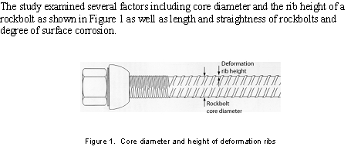
Using Visuals
Refer to figure/table in the text
Leave space between text and visual
Caption is usually placed below the figure
Taken from Hagan (nd)

Slide 26
Tables Table 2: ITU-R Classification of Cellular Wireless Systems
Caption is usually placed above the table
ITU Classification
Wireless Technology
Supported Bit Rate
Switching Technology
2G
GSM
10kbps
Circuit Switching
TDMA - IS-136
cdmaOne
2.5G
GPRS
64-144kbps
Packet Switching
EDGE
IS-95B
3G
WCDMA
384kbps - 2Mbps
Packet Switching
UWC-136
cdma200
(Source: Nyandoro 2001)
Acknowledge all sources

Slide 27
Integrate lists into a paragraph
Introduce the list
Computer Aided Process Planning (CAPP) software automates the process of matching a product to a manufacturing process traditionally undertaken by a human expert. This process involves a number of key steps:
Interrogating and interpreting a product Computer Aided Design (CAD) model for its key features;
selecting a machine capable of manufacturing these features, and;
creating a sequence of activities to have the selected machines create the product described by the geometry of its CAD model.
Indent and use numbers or bullets
Use parallel rule
Optional: concluding sentences/comments

Slide 28
Why reference?
Is a tradition in academia and most professions.
Gives credit where it is due.
Gives credibility to your claims and position.
Enables the reader to ‘back track’(i.e. verify) the ideas/information.
Shows the depth & breadth of your research
Avoids accusations of PLAGIARISM!!!!!

Slide 29
When do I reference?
Ask yourself, “How do I know this?”
If you answer , “I read about it in ….” ,
Then reference!
“Do I reference other peoples’ images, figures, tables, photographs?”
Yes, because anything in an assignment that is not ‘yours’ must be acknowledged.
“Do I have to reference even if I put it in my own words or change the image/data a bit?”
Yes, your paraphrases, summaries, quotations, and adapted information must be acknowledged

Slide 30
In text referencing
Harvard system ( Author surname and year of publication).
As Moran (1980) showed . . .
Various workers (Wilson,1970; Smith, 1975; Brown and White, 1985) found that . . .
For three or more authors*
Wilson et al. (1992) describe …..
*However, in the list of references at the end of the document the names of all the authors and their initials should be given.
NOTE: Failure to reference may be considered plagiarism for which there are penalties…
Single author
Multiple publications
et al. = and others

Slide 31
In text referencing
Number citation system [1]. *
The first reference you use takes the number [1], the second [2] and so on. A reference keeps the number it was first assigned throughout the report.
As Moran [1] showed . . .
Various workers [1,3-4] found that . . .
For three or more authors* *
Wilson et al. (5) describe …..
* In the reference list organise the citations in order according to the number they were assigned in the body of the report.
**However, in the list of references at the end of the document the names of all the authors and their initials should be given.
NOTE: Failure to reference may be considered plagiarism for which there are penalties…
Single author
Multiple publications
et al. = and others

Slide 32
Using sources well
In most Australian underground coal mines, rockbolts form the basis of the primary roof support system. Previous studies have found however that despite an estimated industry-wide annual expenditure of over $A35 million on rockbolts, it is estimated that 30%-35% of the rockbolts do not perform to specification and may represent some risk to the maintenance of a safe workplace environment (Galvin et al 2001).
Sources provide the background to the problem/topic
Extract from Hagan (nd)

Slide 33
Introduce the source smoothly- give some context
Various researchers have noted the importance of minimising resin thickness. For example Franklin and Woodfield (1971) found when using a 19 mm rebar, a resin annulus of 6.4 mm resulted in the most rigid and strongest anchorage system. Durham (1973) suggested an optimum range of resin annulus of between 4 and 6 mm.
Sources provide facts/ definitions/opinions on an aspect of the topic
Extract from Hagan (nd)

Slide 34
List of references
List all sources cited in the text under the heading ‘REFERENCES’ at the end of the typescript.
*Harvard style: Arrange the list ALPHABETICALLY by the surname of the first author followed as needed by the second author and so forth.
Govindan, K, Vorster, M, Martinez, J and Rakes, T, 1999. Improving mine management through data mining, in Proceedings 28th International Symposium on Computer Applications in the Minerals Industries (ed: K Dagdelen), pp 637-645 (The Society for Mining, Metallurgy, and Exploration Inc: Littleton).
Generally italics are used for the name of the covers in which the referenced material resides.
Remember that it is better to give too much detail than not enough to identify and find the publication.
Authors’ names
year
title
Cover name
publisher

Slide 35
Alphabetical order
References
ASTM 1995. Standard Specifications for Roof and Rock Bolts and Accessories, F432 (American
Society for Testing Materials).
Cox, R H T and Fuller, P G, 1977. Load transfer behaviour between steel reinforcement and cement
based grout, CSIRO Division of Applied Geomechanics, Technical Rpt No 40.
Fabjanczyk, M, Hurt, K and Hindmarsh, D, 1998. Optimisation of roof bolt performance, in
Proceedings International Conference on Geomechanics/Ground Control in Mining and
Underground Construction, pp 413-424 (The Australasian Institute of Mining and Metallurgy:
Melbourne).
Franklin, J and Woodfield, P, 1971. Comparison of a polyester resin and a mechanical rockbolt
anchor, Transactions of the Institute of Mining and Metallurgy, (A)80:91-A100.
Galvin, J M, Offner, J C, Whitaker, A, Fabjanczyk, M, and Watson, J O, 2001. Establishing
anchorage and failure mechanisms of fully encapsulated roof support systems – end of grant
summary report. UNSW Mining Research Centre, ACARP Project C7018.
Hocking, R J, 2000. A study of the variation of important rockbolt parameters and their impact on
performance, BE thesis (unpublished), University of New South Wales, Sydney.
Rockfield Technologies Australia, 2006. Structural integrity analysis of underground cavities and rock bolts, Available: http://www.rocktech.com.au/indus_min.html (Accessed March 3, 2007).
Yeaby, M, 1991. Practical guide to rock bolting. (ANI Arnall).
Standard
Report
Conference paper
Journal article
Thesis
www
Book
Sample reference list adapted from Hagan (nd)

Slide 36
Advice on referencing and avoiding plagiarism
Take useful notes (which means…?)
Do not cut and paste - write it in your own words.
Note the source details!
Think about how you can use the information to support your ideas/main points
Be consistent - read the ‘rough guide to presenting assignments’
Follow advice from your school, lecturer, mentor…

Slide 37
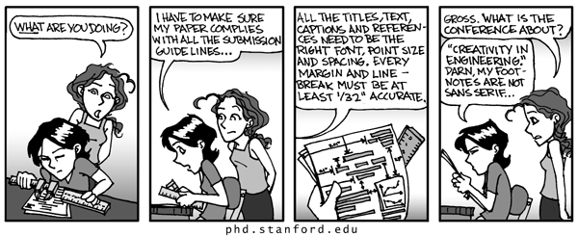
Presentation is important!
Your aim is to produce a professional and technically accurate report.
LOOK AT: ENGG1000 - Communication Skills section - contains this slide show, the ‘rough guide’ and online tutorials on design reports!
In your proejct area review the design report TEMPLATE
and read your project instructions – stay on topic!

Slide 38
Formatting the report
→Communications Lectures topic ( contains this slide show, the ‘rough guide’ and online tutorials on design reports! )
Also read your project instructions

Slide 39
What are some features of good writing?
There is usually a clear beginning, middle and end to the text.
The main argument/position and purpose of the text is clearly stated.
The main supporting points are clearly expressed.
Supporting points and explanatory information are logically organized.
The writing style is consistent and appropriate for the audience.
There are no spelling or grammatical errors.
Visuals are used to illustrate and extend information.

Slide 40
Paragraphs usually contain a main point and supporting information
A saucepan is a useful utensil.
Main point
You can use it to boil water, or to carry water. Some hairdressers use to guide their scissors. You could make a stew in it. At a pinch, it could double as a hat.
Source: Henry J, Writing English for Academic Purposes, USQ (n.d.)
Supporting sentences

Slide 41
The importance of rewriting !
Version 1 (166)
As we progressed through the construction phase, we needed to refocus on the marking criteria and design objectives as overall, this task was indeed about our grade as well as going fast.
We had minimised the cost by using simple materials throughout the construction and had kept well under budget, so this was not a concern for us. In terms of simplicity, our group heavily considered this and reworked our construction design so that the fan housing and chassis were separate components that could be transported and stored much easier; locking together simply on race day. In terms of manufacturability, our group considered this to be a difficult concept for this task, as it seemed far-fetched the models would be mass-replicated. However our group did use simple materials and minimised the amount of moving parts to enhance the overall manufacturability, as well as simplicity. The team felt that the redesigned fan-box and in particular the previously designed space-frame chassis would contribute well to the innovation marks.
Version 2 (140)
Throughout the construction phase, the team needed to refocus on the marking criteria and design objectives as overall, this task was indeed about grades as well as speed.
Cost was minimised by using simple materials throughout the construction to ensure the project remained under budget. In terms of simplicity, the construction design was reworked so that the fan housing and the chassis were separate components that could be easily transported and stored, and then locked together on race day. In terms of manufacturability, the team considered this to be a difficult concept as it seemed unrealistic that the models would be mass-produced. However use of simple materials and a minimum number of moving parts does enhance the overall manufacturability, as well as simplicity. The redesigned fan-box and in particular the space-frame chassis design should contribute well to the innovation marks.

Slide 42
What distinguishes a pass from a distinction in writing?
Essay Question: The cat sat on the mat. Discuss.
Fail:
The cat sat on the ground.
Fail/pass:
The cat sit on the mat.
Pass/Credit:
The cat sat on the mat, which made the mat flat.
Credit/Distinction:
The cat sat on the mat, which made the mat flat. Therefore cats should be kept off mats.
Distinction/HD:
The cat sat on the mat, which made the mat flat. Smith (1996, p.7) demonstrated that “cats sitting on mats have a positive effect on compressibility”. One solution is for cats to be kept off mats. A better solution is for cats to be provided with non-compressible seating.
Source unknown- Adapted from: UOSS Course Notes (2003) The Learning Centre. UNSW.

Slide 43
To develop a consistent style and clear writing
Follow advice – formatting & style of writing
Notice how good writers organise ideas and express opinions –choose similar structures and expressions
Use checklists & assessment guidelines/criteria
Give text ‘the drawer treatment’
Be prepared to rewrite a text more than once!
Recognise when you have a problem and do something about it; such as….

Slide 44

Recommended Resources
iWRITE- (see the Communications Lectures topic in Moodle ) http://iwrite.unsw.edu.au/iwrite/ENGINEERING/Reports/Design-Reports/Writing-Engineering-Design-Reports.html
Writing Clearly (paragraphs) http://iwrite.unsw.edu.au/iwrite/ENGINEERING/Writing-Clearly/Writing-Clearly-intro.html
Learning Centre services – consultations, workshops, online resources. http://www.lc.unsw.edu.au

Slide 45

Question Time!

Slide 46
References
Dominick P, Demel J, Lawbaugh W, Freuler R, Kinzel G, & Fromm E, 2001,Tools and Tactics of Design, John Wiley, New York, pp187 –191.
Hagan P, & Mort P, 2006, Guide to writing in mining engineering, UNSW, Sydney Australia.
Voland G, 2004, Engineering by Design”, Pearson Prentice Hall, New Jersey, pp14-16, pp 410-411.

Slide 47
Week 2 ID Writing task news
You can now view your feedback and grade.
Read the file that says ‘Read this first!’
Remember the 4 ratings are NOT MARKS – they are FEEDBACK – your individual writing profile
The mark in the grade book is based on the content and relevance of your answer – n/5%
If you want help advice on developing your writing can email Pam Mort

Slide 48
Please see Pam at the end of the talks to collect your week 2 writing task
Shabrina Yursi
Huang Yibin
Brandon Wong
David Leydon
Rahul Gounder
Xuewen Fan
Niyousha Balouchgharaei
Anusha Rana
Eric Kim
Zachary Newling
Maxwell Yan
Cass Wei Gwen Lai
Amarkeshan Sabesan
Johnathan Liang
Chritos Emmanouilidis
Pabodha Gubarathe

